Slide 1

Thesis: Implicit racial bias consciousness is a better solution for eliminating implicit racial bias evident in prosecutorial discretion, than blinding prosecutors to the defendant’s race.
[Name Redacted]
https://www.google.com/search?q=law&source=lnms&tbm=isch&sa=X&ved=0ahUKEwjMj8fkp_TXAhXJJiYKHTZXBKIQ_AUICygC&biw=1504&bih=897#imgrc=qEGT36J-2JlAeM:

Slide 2
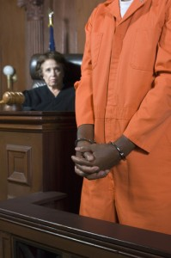
Implicit Racial Bias Defined
“Unconscious stereotypes and attitudes that we associate with racial groups” (Richardson, 2017)
It is “Cumulative and infects every stage of the criminal justice system” (Chin, 2016)
https://www.google.com/search?biw=1504&bih=897&tbm=isch&sa=1&ei=aFMnWtzbIcHjmAG1w6OgCg&q=black+defendant&oq=black+defendan&gs_l=psy-ab.3.0.0j0i24k1.78740.85111.0.88704.14.12.0.2.2.0.153.1087.7j5.12.0....0...1c.1.64.psy-ab..0.14.1109...0i67k1j0i30k1j0i5i30k1.0.4jE5QN0RQvo#imgrc=beDY0La5OC46pM:

Slide 3
Prosecutorial Discretion
“Called upon to make judgments that involve unstable and contested criteria” (Murray, 2012)
Ambiguities that present risk to negative stereotypes(Murray, 2012):
  unresolved questions regarding whether the evidence points toward the defendant's guilt, or, even if the defendant is guilty
  whether the defendant is a danger to society
  capable of rehabilitation
  morally deserving of a long prison sentence

Slide 4
Implicit Racial Bias in Every Stage of Prosecutorial Discretion
Charging: “Black defendants are nearly twice as likely as White defendants to be charged with crimes that carry mandatory minimum sentences.” (Chin, 2016)
Incarceration: “Black men were incarcerated at a rate over six times that of White men.” (Chin, 2016)
Bail: ”Black defendants are subjected to higher rates of pretrial detention and higher bail amounts than White defendants." (Chin, 2016)

Slide 5
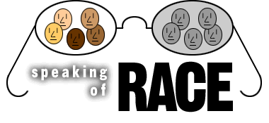
Blinding Prosecutors To The Defendant’s Race
Already used in capital punishment cases (Sah, Robertson, & Baughman, 2015)
Charging Decisions (Sah, Robertson, & Baughman, 2015)
  Petty Offenses- Prosecutors don’t usually meet with defendant before initial charges
Plea Bargaining (Sah, Robertson, & Baughman, 2015)
  Prosecuting & Defense Attorneys negotiate deals → Prosecutor doesn’t need to be aware of race
Replacing defendant’s name w/numbers to keep from inferring race (Sah, Robertson, & Baughman, 2015)
https://www.google.com/search?biw=1504&bih=897&tbm=isch&sa=1&ei=rFQnWs-ENsGamQGj3aPYCQ&q=color+blind+race&oq=color+blind+&gs_l=psy-ab.1.8.0j0i67k1l5j0l2j0i67k1l2.11189.11189.0.14959.1.1.0.0.0.0.84.84.1.1.0....0...1c.1.64.psy-ab..0.1.80....0.1MgTyFcfn-g#imgrc=gR29a0SO4zOayM:

Slide 6
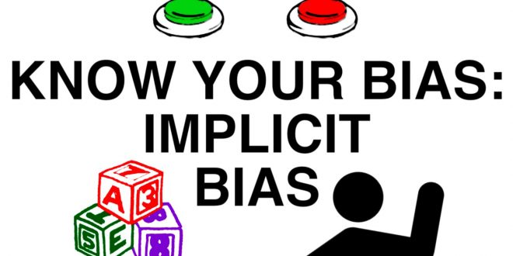
Color Conscious Prosecutorial Discretion
“Acknowledge and strive to understand their own racial stereotypes about blacks, and to identify the situations in which those biases are likely to influence their decision-making.” (Murray, 2012)
  IAT
Discretion (Murray, 2012)
  Decide not to seek indictments based on unjust criminal laws
  Offer more equitable plea arrangements based on other laws
  Recommending sentences that are commensurate with the true nature of the offense
Challenge racial profiling (Murray, 2012)
Select racially balanced jury (Murray, 2012)
http://quantumphysicsofbeliefs.com/understanding-implicit-bias/

Slide 7
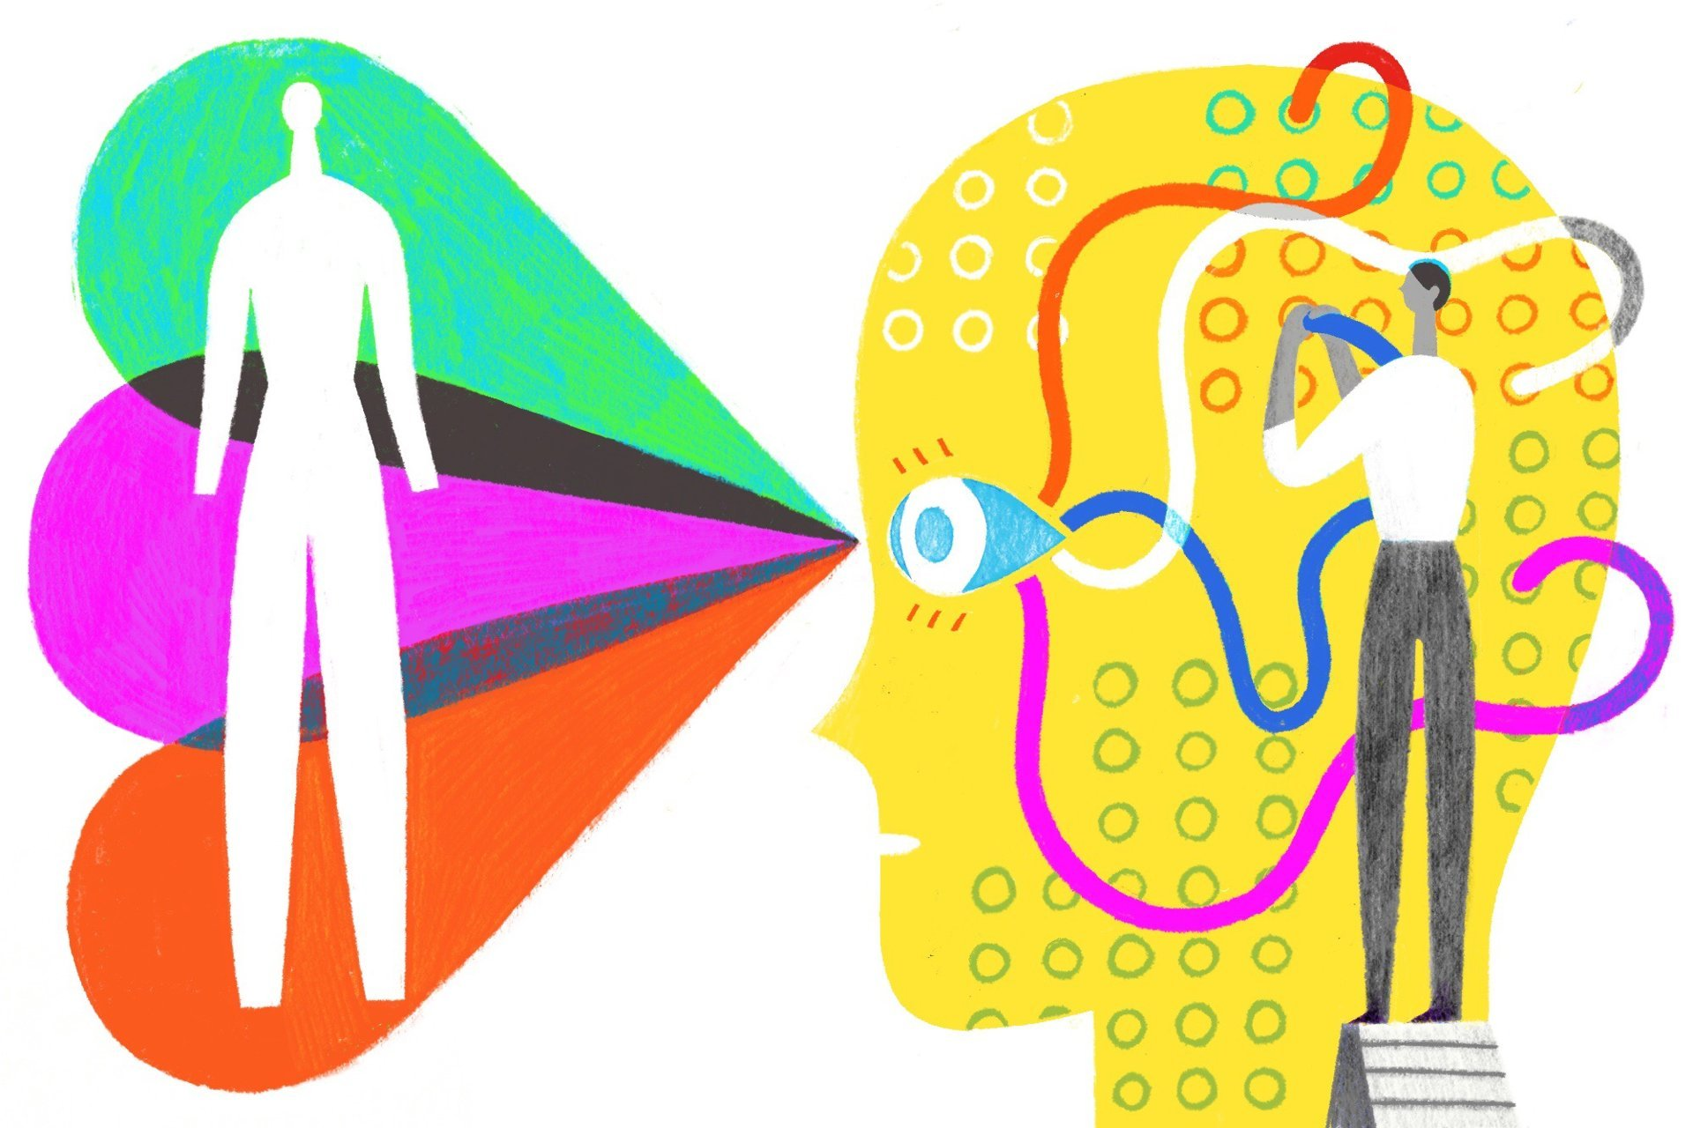
Why Implicit Racial Bias Awareness is Better
Race is necessary to know in hate crime cases
Awareness of it is the first step to actively combatting it (Can’t eliminate implicit racial bias if you don’t know it exists)
Not every case is clear, prosecutors have to use their judgement based off ambiguities to protect communities and place defendants in positions to not reoffend
Blinding race is reductionist and takes away from the defendant’s individual experiences that led up to him/her committing the crime
  Understanding this can help prosecutors use their discretion to help defendant
https://www.google.com/search?biw=1504&bih=897&tbm=isch&sa=1&ei=UlUnWoDVNMvFmwHJ4Im4CQ&q=implicit+racial+bias+awareness&oq=implicit+racial+bias+awareness&gs_l=psy-ab.3...15654.27005.0.27193.20.19.0.1.1.0.426.1655.16j2j4-1.19.0....0...1c.1.64.psy-ab..0.12.871...0j0i67k1j0i5i30k1j0i8i30k1j0i30k1j0i24k1.0.5Bc-4VVySv8#imgrc=WKqPTQdf01EC6M:

Slide 8
Reference List
Chin, William Y. "Racial Cumulative Disadvantage: The Cumulative Effects of Racial Bias at
Multiple Decision Points in the Criminal Justice System," Wake Forest Journal of Law &
Policy vol. 6, no. 2 (June 2016): p. 441-458.
Murray, Justin. "Reimagining Criminal Prosecution: Toward a Color-Conscious Professional
Ethic for Prosecutors," American Criminal Law Review vol. 49, no. 3 (Summer 2012): p.
1541-1598.
Richardson, L. Song. "Systemic Triage: Implicit Racial Bias in the Criminal Courtroom," Yale
Law Journal vol. 126, no. 3 (January 2017): p. 862-893.
Sah, Sunita, Christopher T. Robertson, and Shima B. Baughman. "Blinding Prosecutors to
Defendants' Race: A Policy Proposal to Reduce Unconscious Bias in the Criminal Justice
System." Behavioral Science & Policy, vol. 1, no. 2, 2015, pp. 69-76, ProQuest Central,
https://search.proquest.com/docview/1869485854?accountid=14541.

